Slide 1
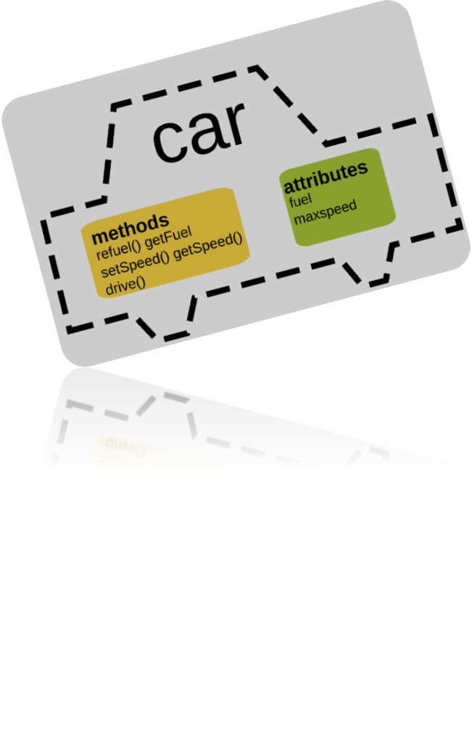
Programming One (csc7061)
Aidan McGowan
Intro to Object Oriented Programming (OOP)

Slide 2

Recall
In Java (and other OOP languages) a program unit called a class hosts the set of methods that perform the class’s tasks.
A class is similar in concept to a car’s blueprints.

Slide 3


Instantiation – make it real !
Car or Object
Build or Instantiation
Blueprint or Class

Slide 4
Declaring a class
You have previously created an object of an existing class Scanner, then used that object to read data from the keyboard.
Now, you’ll create a new (your own design) class, then use it to create an object of another class you have written.

Slide 5
The Greetings App
Two classes - GreetingsManager and MessageCentre
GreetingsManager will be the start point for the application. It uses the MessageCentre to display messages to the user of the system.
GreetingsManager
MessageCentre
displayMessage()

Slide 6

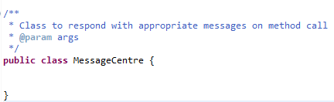
Class declaration
Firstly creating a MessageCentre class.
No main method !
New methods and (instance) variables go here

Slide 7
Methods
Performing a task in a program requires a method.
The method houses the program statements that actually perform the task.
The method hides the statements from the user, similar to the way the accelerator hides the mechanism for speeding a car from the driver.

Slide 8
UML class diagrams – a brief intro
UML (Unified Modelling Language) class diagrams are commonly used to design / describe classes.
MessageCentre
+ displayWelcomeMessage() : void
Notes:
The UML representation of a class is a rectangle containing three compartments stacked vertically.
The top compartment shows the class's name. The middle compartment lists the class's attributes (variables). The bottom compartment lists the class's operations (methods). When drawing a class element on a class diagram, you must use the top compartment, and the bottom two compartments are optional. If you see a + beside a method name that means that it is public.
the middle compartment is empty, because the MessageCentre class does not have any attributes.
The UML models operations by listing the operation name preceded by an access modifier (in this case +) and followed by a set of parentheses. Method displayWelcomeMessage does not require additional information to perform its tasks, so the parentheses following
the method name in the class diagram are empty, just as they were in the method’s declaration. The plus sign (+) in front of the operation name indicates that
displayWelcomeMessage is a public operation in the UML (i.e. a public method in Java).

Slide 9
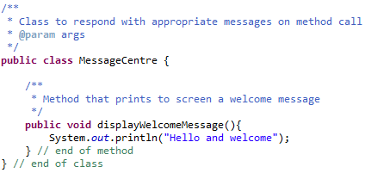
Adding a Method to the MessageCentre class
New method

Slide 10
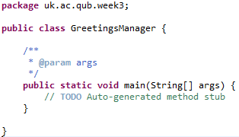
Class declaration
Creating a GreetingsManager class.
Start point – the main method !

Slide 11
Instantiating the MessageCentre
In order to use the instance methods, variables etc. of the MessageCentre class you will need to create (instantiate) an object of the type MessageCentre
The phrase "instantiating a class" means the same thing as "creating an object." When you create an object, you are creating an "instance" of a class, therefore "instantiating" a class

Slide 12
Instantiating
The new operator instantiates a class by allocating memory for a new object and returning a reference to that memory. The new operator also invokes the object constructor.
The new operator requires a single argument: a call to a constructor. The name of the constructor provides the name of the class to instantiate.

Slide 13
Instantiating – general format
The new operator returns a reference to the object it created. This reference is usually assigned to a variable of the appropriate type, like:
Point originOne = new Point(23, 94);
This example creates a object of type Point and passes in two int arguments (23 and 94).
The object is then referred to as originOne

Slide 14
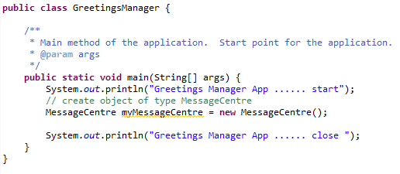
Instantiating the MessageCentre
Create the object

Slide 15
Invoking a method
To invoke a method in another class you will need a knowledge of the method signature. You must compile with the signature or a compile time error will occur.
Remember the MessageCentre class has the following declared ..
Method to be invoked

Slide 16
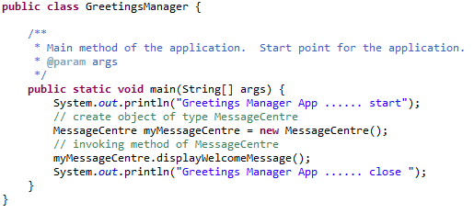
Invoke !
To invoke the displayMessageCentre method …
Invocation (method call)

Slide 17
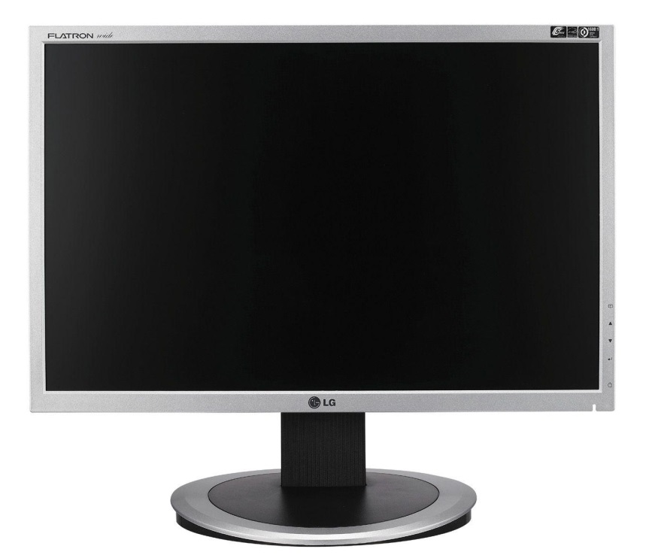

Under the bonnet… follow the Thread
MessageCentre
displayMessage()
Program Start
GreetingsManager
start (main method)
create object of MessageCentre
Output to screen “… start”
invoke method to displayMessage
output to screen “…. close”
Program finished

Slide 18
Updating the Greetings App
Update the UML class diagram
MessageCentre
+ displayWelcomeMessage( timeOfDay : String)
Notes:
However, this version of MessageCentre – displayWelcomeMessage() has a parameter. The UML models a parameter a bit differently from Java by
listing the parameter name, followed by a colon and the parameter type in the parentheses
following the operation name.

Slide 19
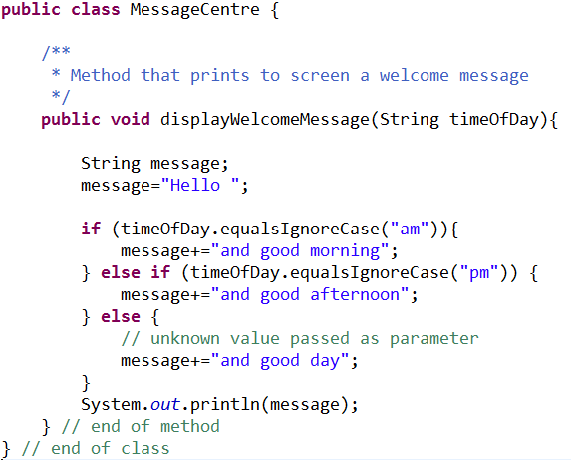
Updating the Greetings App
To make our Greetings App more context sensitive we could parameterise the display method

Slide 20
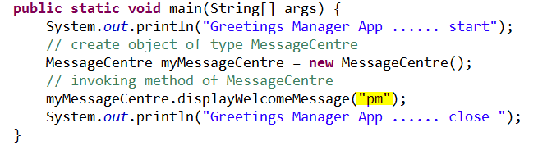

Calling the updated parameterised method
As the method to be invoked requires a String argument we need to supply one from the calling class i.e. GreetingsManager

Slide 21
Exercise I – Calculator class
Create the following class
SimpleCalc
+ add( num1 : int; num2 : int) + subtract ( num1 : int; num2 : int) + multiply ( num1 : int; num2 : int) + divide ( num1 : int; num2 : int)
Create another class (Driver.java) with a main method. Within this method instantiate the SimpleCalc and exercise/ test all four of its methods. Run the Driver.java class.
Notes:
public class SimpleCalc {
/**
* Adds two number together and outputs the
* result to screen
* @param num1 the first number
* @param num2 the 2nd number
*/
public void add(int num1, int num2){
System.out.println(num1+num2);
}
}
______________________________________________________________
public class Driver {
public static void main(String[] args) {
SimpleCalc cal = new SimpleCalc();
cal.add(2, 3);
}
}

Slide 22
Exercise II – Convertor class
Create the following class
cm to inches : cm * 0.394
Inch to Cm : inch * 2.54
Miles To Km : mile * 1.609
Km to miles : km * 0.621
UnitConvertor
+ cmToInches( cms : double) : double + inchesToCms( inches : double) : double + kmToMiles( kms : double) : double + milesToKms ( miles : double) : double
Create another class (BuilderHelperApp.java) with a main method. Within this method instantiate the UnitConvertor and exercise/ test all its methods. Run the BuilderHelperApp.java class.
Notes:
/**
* Converts various units
* @author amcgowan
*/
public class UnitConvertor {
/**
* Converts from cm to inches
* @param cms
* @return the cm converted as inches
*/
public double cmToInches(double cm){
return cm * 0.39370078740157;
}
/**
* Converts from inches to cm
* @param
* @return the inch converted as cms
*/
public double inchesToCm(double inch){
return inch * 2.54;
}
/**
* Converts from mile to km
* @param
* @return the mile converted as KMs
*/
public double milesToKm(double mile){
return mile * 1.609344;
}
/**
* Converts from km to mile
* @param
* @return the kms converted as miles
*/
public double KMToMile(double km){
return km * 0.621371192;
}
/**
* ad hoc tests – simulates the BuilderHelper class….
*/
public static void main(String[] args) {
UnitConvertor uc = new UnitConvertor();
System.out.println(uc.KMToMile(160));
}

